Slide 1
Sales Cloud Modules

Slide 2
SalesCloud Features
Features:
1.contacts Management
2. opportunity management
3.Lead Management
4.Reports and Dashboards
5. Salesforec Mobile
6. Email Integration
7.Sales Forecasting

Slide 3
SalesCloudFeatures
8. Workflow Approvals
9. Files sync and share
10. Data management

Slide 4
Contact Management
Know every contact in your customer accounts:Access critical customer data including key contacts, communication history, and more — quickly and easily with Salesforce. You’ll get a complete picture of all your customers, from insights about how to engage with them to deals they're involved in.
Pull in social data for a deeper view of your customers:Use a feed of your customers’ social content to understand what they are saying about products or services. You’ll uncover valuable insights into your customers’ issues, so you can proactively provide answers.
Collaborate with people companywide:Moving your contact management solution online and in the cloud enables collaboration across the organization. Our social collaboration tools are designed for you to share insights, relevant documents, and more on every business record and contact.
Prepare for customer meetings while on the go:Access all of the account and contact data you need to keep deals moving, from anywhere. The Salesforce app on your mobile device pulls in valuable social profile information from your accounts and contacts, giving you deep insights so you can walk into that important sales meeting with confidence

Slide 5
Opportunity Management
Focus on what’s important: View critical details in a rich activity timeline of your customer's activity. Know whom you’re competing against, what stage your deal is in, and what moves you need to make next to win. Track all associated activities as they happen and receive updates when action is needed. Send emails simply with templates just a click away.
Streamline the sales process: Your CRM solution should map to your sales management and business processes, not the other way around. Easily customise our app to reflect your sales and forecasting stages so you can drive process, productivity, and consistency the way you want.
Quickly create up-to-the-minute quotes: Track which products are part of your deal, including quantity, standard price, quoted price, and product codes. Set up revenue and quantity schedules to mirror payment and delivery terms. With built-in quoting capabilities, you can automatically populate a quote with relevant customer data, generate a PDF from an approved template, and email it to customers directly from Salesforce in just a few clicks.
Provide guidance and congrats: Deals happen fast. Keep your team informed with real-time updates using the Salesforce mobile app. Update your deal status, pull in teammates for help, and more — all from your mobile device.

Slide 6
Lead Management
Convert more leads into actual opportunities : Salesforce lets you track all the right information about your CRM leads. The rich activity timeline lets you see and access the most up-to-date contact information while understanding best practices and relevant documents using Sales Path. You can even see where a marketing campaign lead came from, read the relevant insights you can act on, and write and track emails from the CRM solution. It’s everything you need to convert more leads, faster.
Route and assign leads to the right people: Set up automatic lead scoring and routing to ensure leads never fall through the cracks, and that the right sales reps follow up on leads while they’re hot.
Track marketing campaigns across all channels: Be a successful lead tracker from capture to close. You’ll be able to manage and track campaigns across all channels, including social media. This will help you make smarter decisions about where to invest, and show the impact of your marketing activities on your sales pipeline.

Slide 7
Reports and Dashboards
Build reports without help from IT:Our CRM analytics software keeps you updated with customized sales forecasting reports that you can build with ease. Just drag and drop the fields, filters, groupings, and charts that you want, and get an immediate real-time view.
Modify charts in your report, on the same Screen: Track team performance with dashboards and other sales reporting tools, and quickly make changes to components to get the most important information front and center.
Make critical decisions from anywhere: Use the customer analytics software within Salesforce to help you check on your key business metrics from anywhere. From email and opportunity management to tasks and collaboration, get what you need to close deals faster, on any device

Slide 8
Go mobile with the complete CRM solution
Manage your day on a single, unified app: View meetings, events, and get account updates on the go with just one app. Join conference calls with a tap, and take meeting notes while in motion. Access and update your CRM data anytime, even while offline.
Close deals fast :Track accounts and approve deals on the go. Be more productive with in-app notes, events, and task management. Get real-time views of sales performance with dashboards and reports.
Collaborate with your team :Connect instantly with your colleagues and team members. Create, view, and manage conversations. Send photos or files as attachments for instant collaboration.
Access all your files from anywhere: Quickly access your files while you’re away from your computer. Easily find files already uploaded to Salesforce and also browse, edit, and share all your files, including Microsoft Office, with just a few taps.

Slide 9
Sell smarter from your inbox with Salesforce email integration.
Transform your email into a powerful selling tool: Get a complete view of all your customer interactions with Salesforce integration to Outlook or Gmail. Capture emails instantly into Salesforce, keeping you and your entire team up to date.
Create new deals or cases from your email :Bring any business process right into your favorite email app with Salesforce integration. Create new deals, log support requests, and more — all with just a few clicks.
Get deeper customer context from every email: Make every event and correspondence count. Keep your email, contacts, and calendars seamlessly synced with your Salesforce data across both desktop and mobile.
Boost productivity by eliminating repetitive tasks: Stay on top of your accounts without wasting time with manual data entry. Let Salesforce log and organize all essential emails for you and spend more time with customers.
Take email integration further with artificial intelligence: Supercharge your sales productivity with AI features in Salesforce Inbox. Move deals forward faster and sell smarter using AI-driven insights — all from your email, on the go, or at your desk.

Slide 10
Sales Forecasting
Get an accurate view of your entire business with comprehensive forecasts :See a complete view of your entire pipeline and your business, and take action where necessary. Provide rapid updates to help management make decisions. Then easily apply your judgment to forecasted amounts at the rep, period, and summary levels. You can also view details about any previous adjustments that you or your team has provided, while leaving the underlying opportunity data intact.
Track your top performers: See which reps are on track to beat their targets with real-time leaderboards. You'll be able to set your goals even higher with a flexible performance chart.
Forecast for complex sales teams: Even if your company has a complex sales organization, Salesforce can help. Overlay Splits allows you to credit the right amounts to sales overlays, by revenue, contract value, and more. You can then view the forecast by overlays to see how they’re contributing to your number. You'll also be able to make real-time adjustments.

Slide 11
Workflow and Approvals
Set your business processes and approval requests to be finished automatically: Process Builder provides a simple point-and-click interface to automate business processes. You can create automatic email alerts for deals over a certain size, auto-assign tasks as a deal moves through the different stages, and more.
Visualize and create any process with drag-and-drop simplicity: Complex sales processes can be automated with drag-and-drop actions in Process Builder. Create workflows that guide sales agents through qualification conversations, intelligently recommend next steps on a deal, or automate manual tasks like filling out orders or putting together complex proposals.
Simplify the approval process to keep deals in motion :Automate the approval process for simple or sophisticated business requests, including deal discount approvals, and travel and expense reports. You can respond to approval requests directly in Chatter, or via email.

Slide 12
Files Sync and Share
Collaborate on files as a team from anywhere, on any device: Collaborate on a wide range of files as a small team, across your organization, or externally with customers. Follow files and be notified when a new version is uploaded. See version history and comments. Drag and drop multiple files for fast and easy uploads to Salesforce. And maintain complete control over sharing settings, including who has viewing, editing, and collaboration rights.
Search for and find files, fast: Put all of your files, content, and customer information in one place to make it easier than ever to find what you’re looking for. With quick filters, you can find what you need by group, library, most recent, and your own files. You can also follow a file to ensure you never have to search for it again.
Publish the latest information and eliminate mistakes: Keep the most up-to-date sales tools in front of your sales and marketing teams. Eliminate mistakes in the sales cycle by managing and publishing the most accurate product specs, contract documents, and price lists. Quickly see commonly viewed files, get real-time alerts whenever content is updated, and use tags to easily classify content across libraries.

Slide 13
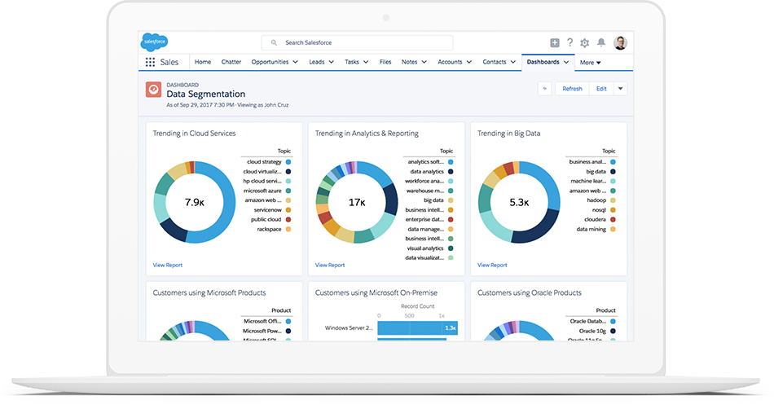
Boost the power and reliability of Sales Cloud with powerful data cleaning tools(Data Management)

